Slide 1


IPC Chronic Level 1 Training - Session 15
Step 3 – Identify periods with non-exceptional circumstances
IPC Food Security Working Group
IPC Global Partners

Slide 2
Learning Objectives
By the end of this session you will be able to:
Recall what are Non-Exceptional Circumstances (NECs)
Recall the importance of NECs for IPC Chronic Analysis
Describe the two parts of the process to identify NECs
Explain the tool and procedures for the identification of Non-Exceptional Circumstances
Notes:
No special notes

Slide 3
Definition of NECs
NECs are periods without significant adverse impacts of unusual shocks.
Shock is an unpredictable event that results in a significant impact on food security (positive or negative) from within or outside the area of analysis.
Impact of shocks is the effect on households’ food and income sources caused by one or more shocks. Usually outlast its occurrence.

Slide 4
Definition of NECs
Unusual shocks are shock events that are severe, widespread and rare.
Quarters are the time period for identification of shocks, impacts, and non-exceptional years. 10 most recent consecutive calendar years are included in the analysis.
Structural change is the result of events that have significantly changed the food security situation and is expected to continue in the future. NECs to be used in chronic food insecurity

Slide 5
Importance of NECs
  Persistent food insecurity is determined based on analysis of conditions under Non-Exceptional Circumstances.
  The Reference Table lists global thresholds for indicators as they would be during non-exceptional periods/circumstances.
    Especially NB for quick-changing indicators,
    Evidence collected during exceptional years may only be used from exceptional years with caution and using inferences - reliability value can only be “somewhat reliable” and cannot account for confidence categorization.

Slide 6
Structural Changes
Structural change refers to a long-term shift in the fundamental structure of an economy.
Structural changes mainly due to acute events are relevant for identification of non-exceptional years.
Gradual structural changes that are mainly a result of socio-economic and political development are not included to identify years before structural change.
Evidence collected before structural changes cannot be directly compared to the IPC Chronic Reference Table.
Structural change is the result of events that have significantly changed the food security situation and is expected to continue in the future. NECs to be used in chronic food insecurity only after structural changes

Slide 7
2-Part Procedure for Identification of periods with NECs
Done in two parts:
I - Identification of periods with impacts of unusual shocks at national level – Done before analysis workshop, and verified in the analysis
II - Identification of Non-Exceptional Circumstances at Area Level – Done during the analysis

Slide 8
Procedures
Done in two parts:
I - Identification of periods with impact of unusual shocks at national level – Done before analysis workshop and verified in the analysis
II - Identification of non-exceptional circumstances at Area Level – Done during analysis workshop

Slide 9
Overview Part I – National Impacts of Unusual Shocks
Periods of impacts of nationally relevant unusual shocks
Those that have impacts across the country
Shocks that are limited to one geographical area but had impacts noted at the national level may also be included in this step.
The identification of periods with impacts of exceptional shocks sets the stage for area level analysis.

Slide 10
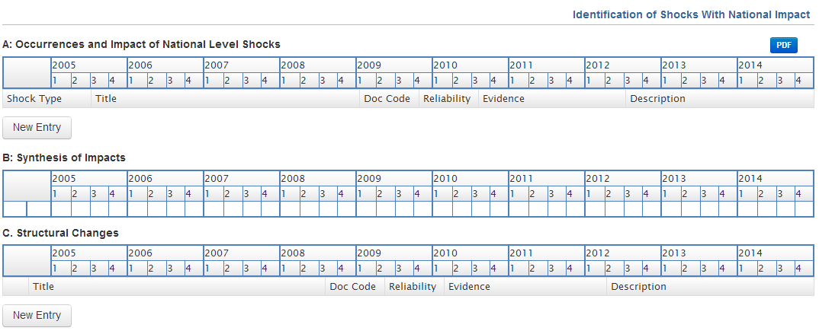
Tool for Part I: National Impacts of Unusual Shocks

Slide 11
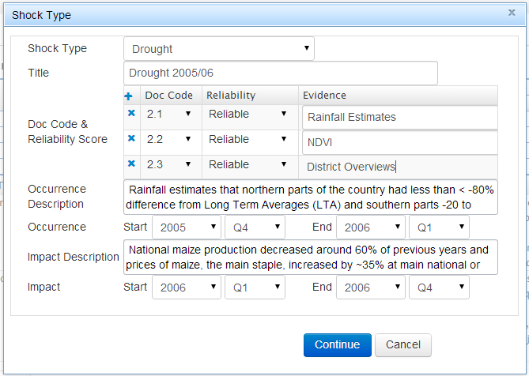
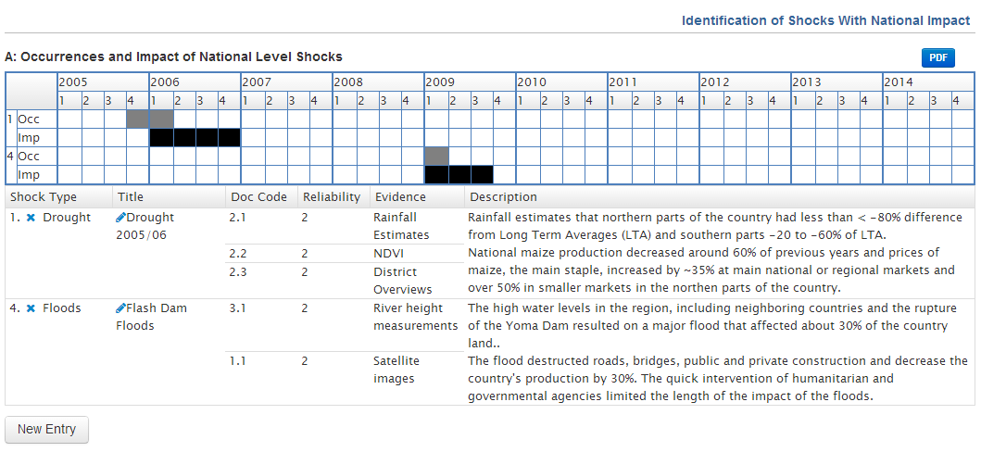
Procedures for Part I – National Impacts of Unusual Shocks
A1. Identify shocks that had a significant impact at the national level during the previous 10 years
A 2. For each shock identified, describe the duration of national impact
Identify Documentation Codes and Reliability Scores

Slide 12
Procedures for Part I – National Impacts of Unusual Shocks
Synthesis of impacts of unusual shocks at national level
In ISS this step is automated on the basis of information inserted in the previous part (A)

Slide 13
Procedures
Done in two parts:
Step I - Identification of periods with impact of unusual shocks at national level – Done before analysis workshop, and verified in the analysis
Step II - Identification of Non-Exceptional Circumstances at Area Level – Done during the analysis

Slide 14
Overview Part II – NECs for Area
Done for each analysis area
To review and revise the periods of the impacts of national level shocks for the analysis area and
To identify the periods of the impacts of additional shocks relevant to the area.
To review any structural changes
To conclude on the identification of non-exceptional periods for the area.
The periods identified as NECs for the area might be different from those identified at national level.

Slide 15
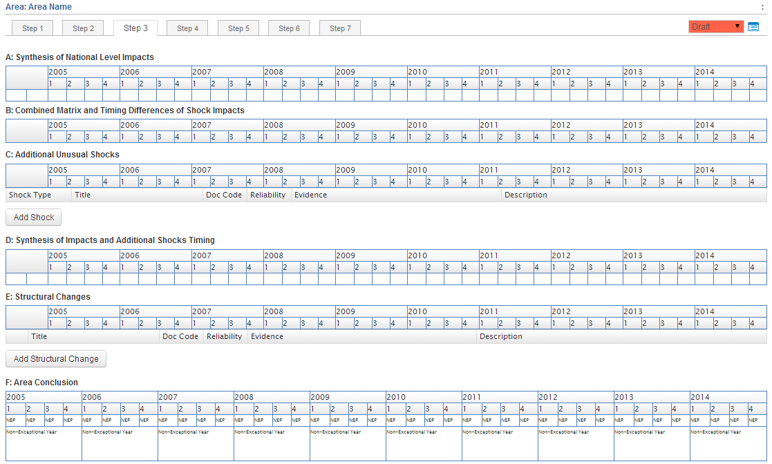
Tool for Part II: NECs for Area

Slide 16
Procedures for Identification of periods with NECs at area level
Synthesize National Impacts
Combined Matrix and Timing Differences of Shock Impacts
Identify Additional Unusual Shocks
Synthesize Impacts and Timing of Additional Shocks
Add any area-level structural changes that impact overall food security conditions
Assign a Conclusion for the Area – automated if using ISS

Slide 17
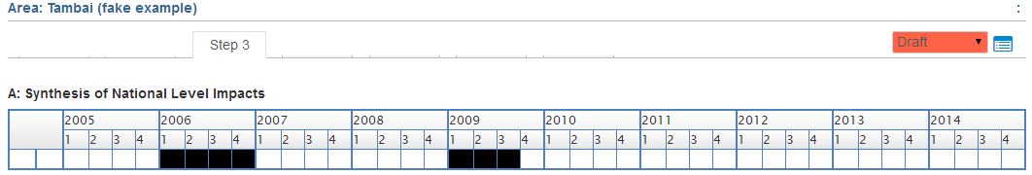
Tool for Part II: NECs for Area
Synthesize National Impacts:
The ISS will automatically generate a row (A) that identifies all quarters of a year during which the country experienced impacts of unusual shocks over the previous 10 years, based on the analysis of impacts of individual shocks.
If analysts are using the Word version of the Analysis Worksheet, this row has to be manually filled in by copying Row B: ‘Synthesis of Impacts’ from the National Shocks Matrix.

Slide 18
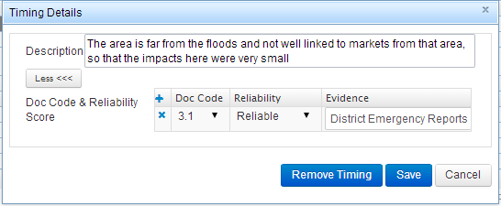
Combined Matrix and Timing Differences of Shock Impacts
Identify differences in timing of impacts of national shocks during the previous 10 years. If the timing of the impacts of shocks identified nationally was different in the area of analysis, the analysts should identify timing differences and include a brief description of them.
  For example, if a certain area in the Central Africa Republic did not suffer from the impacts of the resurgence of violence in 2013/14, this should be noted here.
Relatedly, some impacts of shocks noted nationally may last longer in areas directly hit by it.
  For example, areas hit directly by the tsunami in Indonesia may have suffered from the impacts of the shock for a longer time period than the country as a whole. These differences should also be noted here.

Slide 19
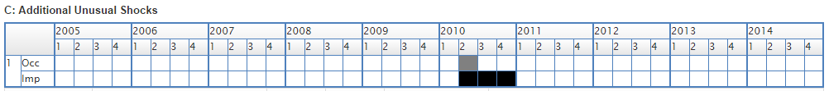
Identify Additional Unusual Shocks at Area Level
The analysis area may have faced additional unusual shocks that had a significant impact on food security situation even if no other area or the country as a whole was not affected.
The timing of the occurrence and impact of these shocks are identified here (row C), as a result of discussions and conclusions reached by the analysis team

Slide 20
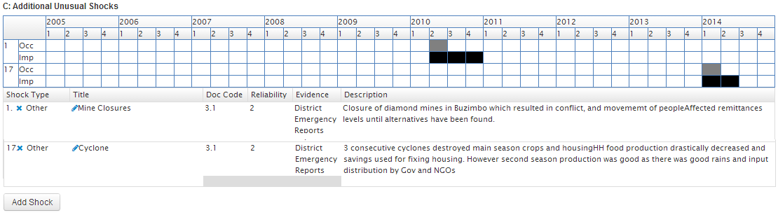
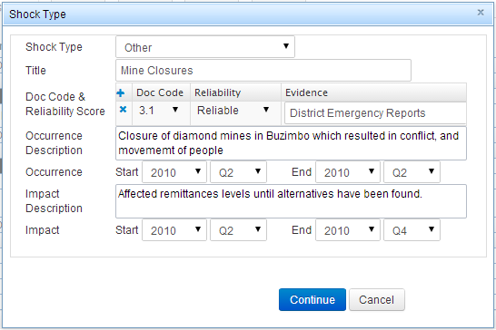
Synthesize Impacts and Timing of Additional Shocks
The ISS will automatically generate a row that identifies all quarters during which the area experienced the impacts of unusual shocks over the previous 10 years based on 1) any revision to timing of impacts from National Shocks for the area under analysis, where applicable (row B) and 2) additional impacts of shocks at the area of analysis (row C).
If analysts are using the Word version of the Analysis Worksheet, this row has to be manually created by highlighting all quarters in which the impacts of any shocks in row B and row C of Step 3 were felt.

Slide 21
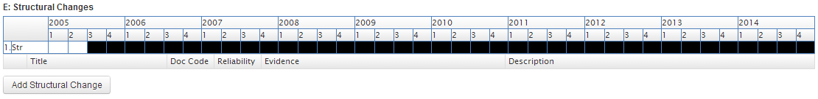
Add any structural changes that impact overall food security conditions
In the rare case that a structural change occurs only at a sub-national level, analysts should add these structural changes to the area-specific analysis of non-exceptional circumstances.
If a locally specific structural change is seen in the area, these changes need to be identified so that evidence collected before the shift is not directly compared against the Reference Table, (refer to Box 9 in the Manual Addendum for discussion on how IPC analyses structural changes).

Slide 22
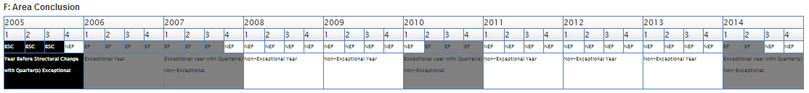
Assign a Conclusion on Quarters for the Area
Conclude, for each quarter of the previous 10 years, if the quarter for the area was: (i) a non-exceptional quarter, (ii) an exceptional quarter, (iii) a period preceding a structural change.
If analysts are using the ISS, the classification of quarters will be automatically done, whereas in Word analysts will need to manually identify each exceptional/non-exceptional quarter.

Slide 23

Complete the National Shocks Matrix
D
I
Y
Exercise 15.1
Task: In plenary...
Fill in the National Shocks Matrix in ISS in your country portal
  By using evidence entered in exercise 13.1 and
  Further discussions and decisions reached in plenary on national impacts of shocks

Slide 24

Wrap up
Do you feel that you can…?
Recall what are Non-Exceptional Circumstances (NECs)
Recall the importance of NECs for IPC Chronic Analysis
Describe the 2-part process for identification of NECs
Explain the tool and procedures for the identification of Non-Exceptional Circumstances for analysis area

