Slide 1


IPC PROCESSES AND TOOLS
workshop

Slide 2

ANALYSIS IMPLEMENTATION
AN EXAMPLE OF HOW TO ORGANIZE THE ANALYSIS TEAM…
IPC LEVEL 3 LEAD
FACILITATORS
Lead
Co-Lead
IPC LEVEL 2 CO-
FACILITATORS
Co-facilitator group 1
Co-facilitator group 2
Co-facilitator group 3
Co-facilitator group 9
Analyst group 1
Analyst group 1
Analyst group 1
Analyst group 2
Analyst group 2
Analyst group 2
Analyst group 3
Analyst group 3
Analyst group 3
Analyst group 9
Analyst group 9
Analyst group 9
IPC LEVEL 1
ANLAYSTS
Analyst
group 1
Analyst
group 1
Analyst group 1
Analyst
group 2
Analyst
group 2
Analyst group 2
Analyst
group 3
Analyst
group 3
Analyst group 3
Analyst
group 9
Analyst
group 9
Analyst group 9

Slide 3
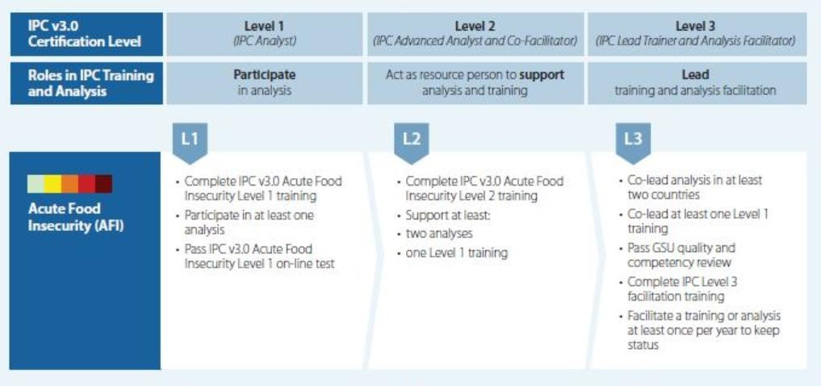
ANALYSIS TEAM REQUIREMENTS & ROLES

Slide 4
ANALYSIS TEAM REQUIREMENTS & ROLES
IPC Analysis team is comprised of….
Lead Facilitator: Lead facilitator should be IPC Level 3 certified from the country or the region. In addition or in alternative, GSU will ensure a Lead Facilitator will support the analysis, either from GSU or from a Global Partner.
Co-lead Facilitator: the Lead facilitator is often accompanied by a co-lead facilitator, IPC Level 3 certified or applicant, from the country or the region. In addition or in alternative, GSU will ensure co-lead facilitators to support the analysis, either from GSU, from Global Partners or through the CCLE program.
Co-facilitators: the IPC Co-Facilitators should be IPC Level L2 or L2 applicant from the country or from the region (CCLE). If no L2 or L2 candidates are available in the country, GSU will ensure support from Co-facilitators to support the sub-groups analysis through the CCLE program.
Analysts: When possible, the analysis should be conducted by IPC Level 1 certified analysts or at least by analysts who have attended the IPC Level 1 training.
LEAD (AND ARE ACCOUNTABLE OF) THE WHOLE ANALYSIS PROCESS
ENSURE SMALL GROUPS CO- FACILITATION AND SUPPORT THE LEADS AS NEEDED
PARTICIPATE AND CONTRIBUTE TO THE ANALYSIS WITH THEIR EXPERTISE

Slide 5
LEAD FACILITATORS ROLE
What is in your view the main role of the lead facilitator?
Type in the zoom chat in whatever order

Slide 6
LEAD FACILITATORS ROLE
Lead the analysis planning process together with the TWG including timeline, logistic, administrative, data
analysis, dissemination, etc..
Lead and coordinate the co-facilitators (THE TEAM!), including CCLE, in the analysis preparation (data reanalysis, ISS pre-filling, cc). Brief and share information with them, assess the capacities of each member of the facilitation team to ensure they are attributed relevant tasks
ISS Set up, management, finalization and sharing
Ensure completion:
  consistency of figures, maps and key messages within the IPC Report and to ensure IPC protocols related to communication are adhered to.
  IPC Self-Assessment tool by the TWG under the lead of the IPC Chair and its sharing with the GSU.
Ensure that neutrality is applied throughout all the analysis and reporting process, and that IPC classifications and products are unbiased by political interferences and/or particular agendas of the institutions participating to IPC analyses.
Liaising with the GSU at global level in case of technical and quality issue arising during the analysis.
Request the support of GSU at regional and global level to ensure good quality of IPC communication products.

Slide 7
CO-FACILITATORS ROLE
When possible, the IPC Co-Facilitators should be IPC Level L2 or L2 candidates from the country or from the region (CCLE).
Supporting the IPC analysis preparation, (Step 1, 2, 3) ahead of the IPC workshop, assist the lead facilitator in the planning and preparation phase and participate to meetings organized at this end.
Acting as small group co-facilitators, orient the analyst in the small group through the use of the IPC analytical framework, ensure respect of protocols and analytical parameters, refer to the lead facilitator any issue affecting quality of the analysis
Co-facilitators report to the Lead and co-lead of the analysis. They participate in all coordination meeting prior, during and after the analysis to debrief on the process and quality of the analysis.
They respond to the objectives set with the lead and co-lead facilitator

Slide 8
CCLE ROLE
When assigned to an analysis, the CCLE act as co-facilitators and are asked to fulfil the SAME tasks described for country co-facilitators.
(CCLE checklist – how to manage?)
Make sure they are engaged from the preparation stage
Organize briefing to explain how the IPC works in the country, which is the support needed, what is expected and what are the main criticalities and sensitivities
Introduced the CCLE to the TWG and the AT, explain their role to everybody / offer opportunity to introduce him/herself – remember to thank the CCLE at the end of the anlaysis and let him/her address the plenary
(in presence) If you are a CCLE, make sure you address the plenary to share briefly your experience
and takeaways for IPC in your country
Ensure you rate the CCLE contribution and the CCLE rate the way you managed him (yes, you get scored on the way you work with them!!)

Slide 9
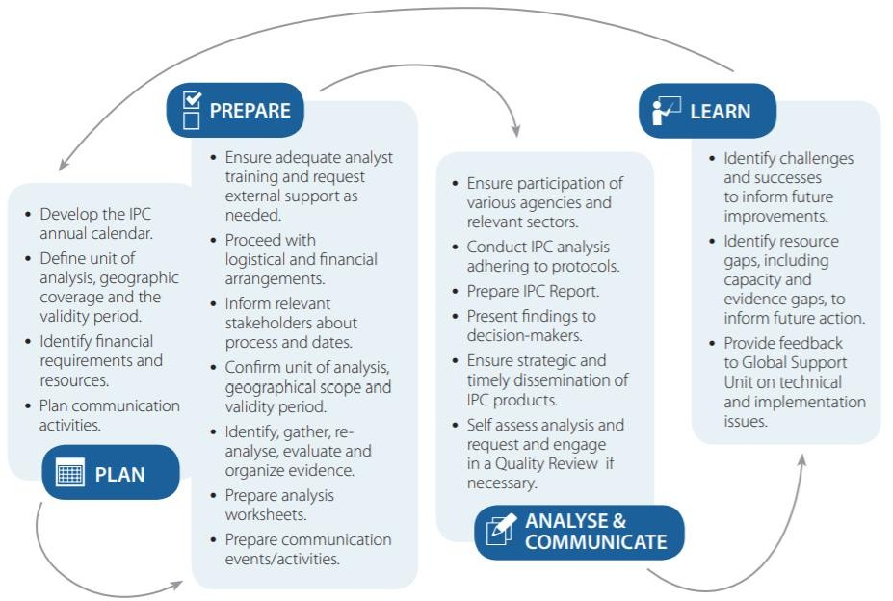
Facilitation team
The IPC Analysis Cycle includes 4 inter-linked stage” that could last between one and three months (AFI, AMN) or longer (CFI) and can vary also depending on the number of areas to analyze:
Technical
Working Group
& Analysis
Team
Technical Working Group
Analysis
Team

Slide 10
PLAN
What are the main things to remind in the planning phase?
Type in the zoom chat in whatever order

Slide 11
PLAN
TIPS:
TWG meeting on planning should include all the agencies so that calendar and processes are agreed upon
During the planning phase an initial screening of data available (data mapping) and deadline for sharing is done – individual follow up on DCT
Plan the analysis at least one week after the data ANALYSIS should be finished (not data collection)
Agree with OCHA on a deadline for sharing and negotiate a breathing room between the analysis and the
HNO
During the planning phase all IPC Partners (mandatory) and other agencies non present should be listed and plan to contact and engage them should be done. Consider different department in the same agency too.
During the planning phase initial agreements on venue, funds repartition, budget, logistics should be made.
Agree on DSA in the planning phase + agree on credit purchase if needed
Invitations should be sent two weeks before, reminder by email one week before and again the Friday before – request confirmation. If context focal points, decide before. Make sure you copy supervisors in the first invitation – do individual follow up of those not confirming.
Ensure translation facilities are provided if needed
Check whether a training or a refresher is needed and organize the trainers

Slide 12
PLAN
What are the main things to remind in the preparation phase?
Type in the zoom chat in whatever order

Slide 13
PREPARE
TIPS:
The more is done in the preparation, the easiest the consensus: analysts focus on debate and are
not in a rush in making decision the last day
CDT and ISS need to be 100% filled
HFA need to be ready and facilitators agree on it in the preparation phase
Consider the week before the analysis as full time IPC work for facilitators / clear your agenda
Prepare EVERYTHING BEFORE (groups, rooms, projectors, access to ISS, templates, backup plans)
Decide when paying the DSA, better split in advance and final payment
It is a team work – avoid putting everything on your shoulders: create a preparation task force / plural and put people in charge based on their competence and interests / ask GSU support EARLY, ask CCLE support EARLY
If virtual, decide how is it going to work and explain by email before the start of the analysis
Ask facilitators to get in touch and have a meeting with his/her group before the analysis to check they have access, understood how it is going to work, timeline, repartition of work

Slide 14
IMPLEMENT
MOST COMMON “SITUATIONS”
Analysis end on Friday with a very short plenary, most people is already packing, they go home without knowing the results, there was no time to discuss about the communication process, the SAT could not be done together
The first day is dedicated to give access to ISS, exchange phone numbers, connect computers, finding
the right room (Physical or virtual room), every group organize in a different way – some by steps,
others by areas, other all current…
Facilitators provide different orientations to different groups regarding the same topic
ISS is not working, participants cannot connect (physical or virtual), participants do not show up,
clearly a whole block of participants is missing (INGOs or UN or nutritionists, etc..)
Results changes after the analysis and is it unclear how, changes proposed inplenary are not appearing/ not done/ done in a different direction than proposed, ..
The first day is for giving access, the second and the third for uploading evidence, the fourth is for
analysis and the fifth of vetting and communication…. So basically the whole analysis lasted one day!!
- Anything else??

Slide 15
IMPLEMENT
TIPS:
Smart agenda (one for analysts one for facilitators)
(if virtual) Ensure facilitators & analysts are in touch, reachable, can communicate
Daily meetings among facilitators
The last day should focus on SAT, vetting, communication (in this order) / Friday does not count
Coping strategies or options to deal with difficult situations
  Connection
  Poor participation / fake participation / disappearing participants
  Non cooperation
  Preparation not done
Remember to link with AMN if available (both way)
WRAP UP ACTIONS:
  Freeze the analysis by downloading PDF and share with core facilitators/ analysts if you want
  Thank you email to agencies and supervisors

Slide 16

VETTING of IPC Analysis
As the lead facilitator you are expected to ensure vetting sessions happens with open neutral and technical debate is allowed and encouraged from the participants.
Carefully chose your chair for the plenary (based on capacity to give everybody voice – should be a neutral body, if the chair is known for not being too neutral, consider alternatives / then GSU or lead facilitator)
Remind the rules of engagement/ NDA and agree on the rules of engagement for vetting prior to the analysis
Leave enough time (but not too much..) for plenary / if small team vetting, also allow a plenary
Organize : modify in real time in ISS – do not allow ‘we will modify and come back to you’ / chat
All discussions in the vetting should be documented (ask a co-facilitator to be the reporting officer)
Project the final map and tell the final number -> PDF-ize the results and share with the core TWG
All analysts should participate in the vetting
For discussion:
  What happens if consensus is not reached in the vetting session?
  What to do if the plenary vetting becomes antagonistic?

Slide 17
COMMUNICATE
Establish and share in the planning phase the date of the release / Prepare a dissemination strategy
/ Agree on if preliminary findings can be published with disclaimer
Agree on if you are going for a donor/HCT presentation prior to publication
Always provide deadline in revision of brief / be smart and innovative: use rotational systems
Decide structure based on what DM might need / watch length/ think of annexes / comparison is very important / include focus (urban, refugees/ etc..) multiple releases of subnational products not welcome by DM / NDA
In plenary vetting : agree on key messages
Assign part of the brief to small groups lead by IPC co-facilitators - make sure relevant distribution of sections (HFA section led by WFP, Availability section led by FAO/MADR, access section led by FEWS NET or WFP, utilization led by WASH cluster/MW, nutrition led by UNCIEF/etc..)

Slide 18
LEARN
TIPS:
Read the previous SAT and QS and try to address the problems
If LL or RQR give it a read
Do the SAT before the vetting / Can be facilitate by lead facilitator/GSU
If easy to address issues, make decisions during the SAT – if complex organize a LL

Slide 19
RED LINES
WHAT IS A RED LINE FOR YOU?
Type in the zoom chat
Most common red lines:
Interference and or lack of consensus
Number of agencies or one agency purposely excluded
Expertise gap
Rejection of data for unjustified reasons
Disturbing facilitator using its role to influence the analysis
No preparation done / no data ready

Slide 20
IPC Budget
When submitting a budget to GSU for approval some things to consider
The activity should be clearly defined and discussed with respective Regional Coordinator
Activities should ideally be divided into 3 clear headings “Training”, “Travel” and
“Consultants”
The budget is sent to the relevant Regional Coordinator for approval
The RC will either send it back with comments, or refer it IPC Country Support Team Leader for approval. Once approved the funds are sent through an FBA to FAO Country office
No specific amount designated but the budgets should be within reason and justifiable based on
Decentralized or not? Delocalized or not? COVID context
Approach of Reimbursement of costs directly incurred in relation with the activity: it is a partnership to which all agencies contributes

Slide 21
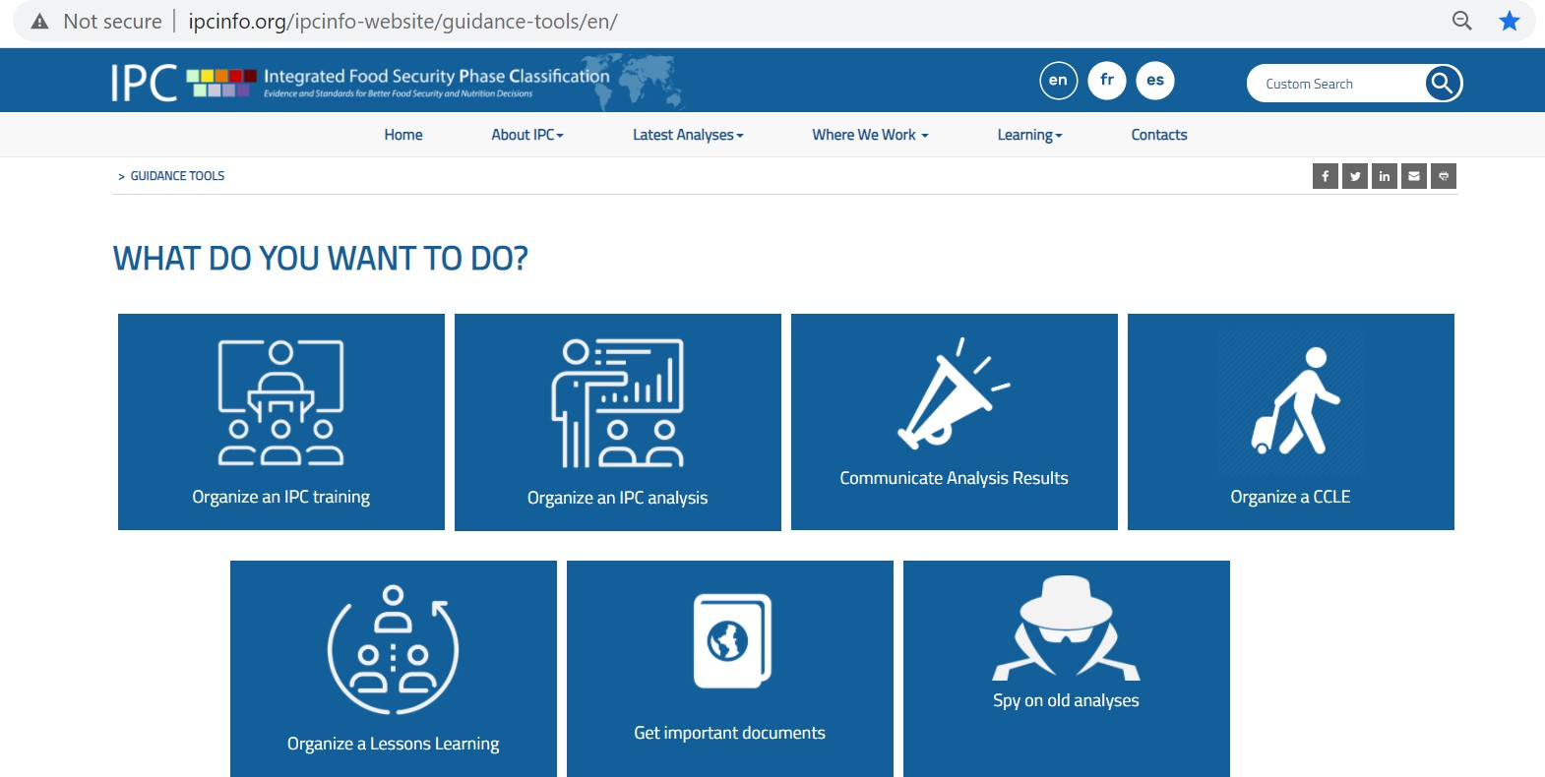

Slide 22
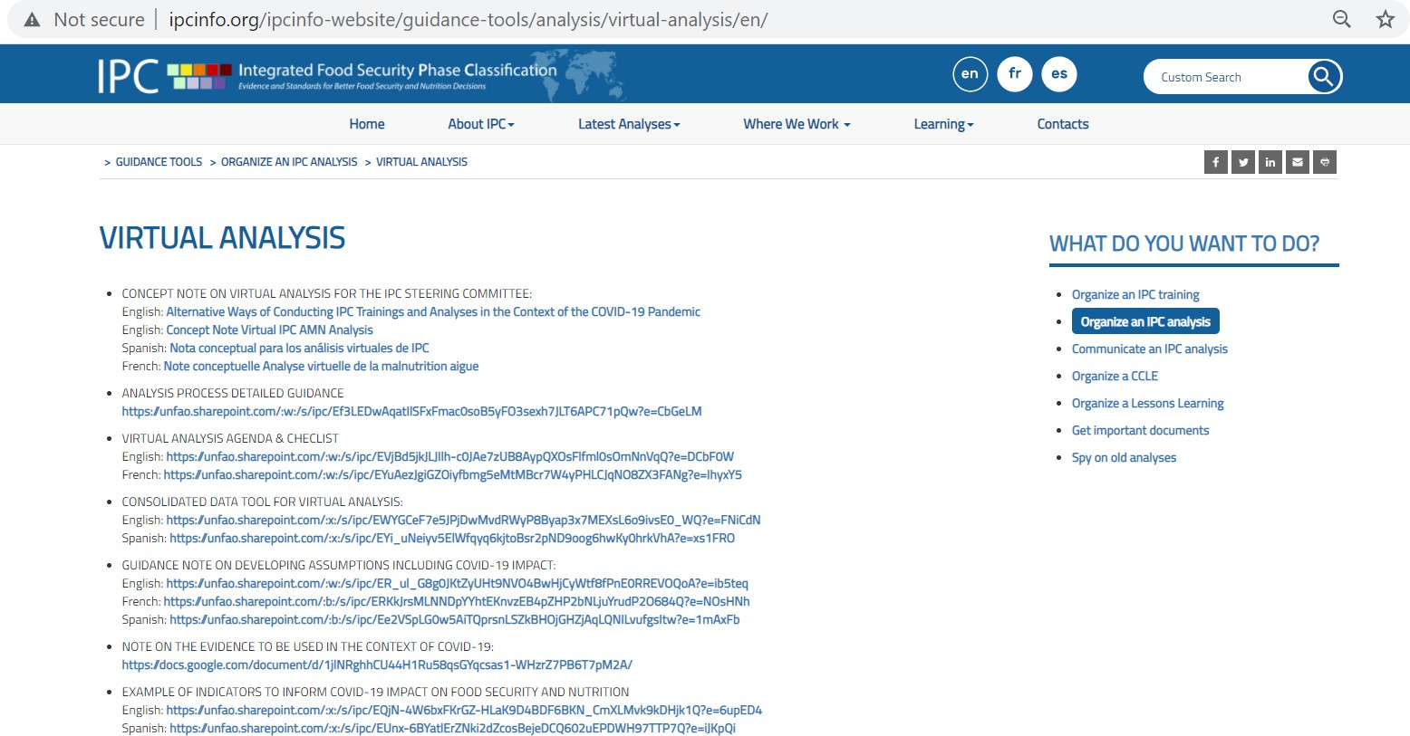

Slide 23

Important Links
1.IPC Website | http://www.ipcinfo.org/
2.IPC Analysis Portal | http://www.ipcinfo.org/ipc-country-analysis/
3.IPC Global Strategic Programme (IPC GSP) | http://www.ipcinfo.org/ipcinfo-website/ipc-global-partnership-and-programme/en/
4.IPC Certification Program | http://www.ipcinfo.org/ipcinfo-website/ipc-systems-login/ipc-certification-programme/en/
5.IPC Online test | http://23.23.115.229/
6.IPC Contacts and Offices | http://www.ipcinfo.org/ipcinfo-website/contacts/en/
7.IPC Events Calendar | http://www.ipcinfo.org/ipcinfo-website/events/en/
8.IPC SharePoint Calendar | https://unfao.sharepoint.com/sites/ipc/Lists/Calendar/Overlay%20Calendar.aspx
9.IPC Training Evaluation Survey | https://www.surveymonkey.com/r/BTBM7XZ
10.Encuesta de Evaluación de Capacitación CIF | https://www.surveymonkey.com/r/IPClearning
11.Évaluation de la formation IPC | https://www.surveymonkey.com/r/XN867VG
12.Evaluation of CCLE Beneficiaries | https://forms.gle/JsaWGdib6ZjWQMNu5
13.CCLE Self Evaluation | https://forms.gle/JMFQmHrKMmiwmixEA

Slide 24

www.IPCinfo.org
The end

Slide 25
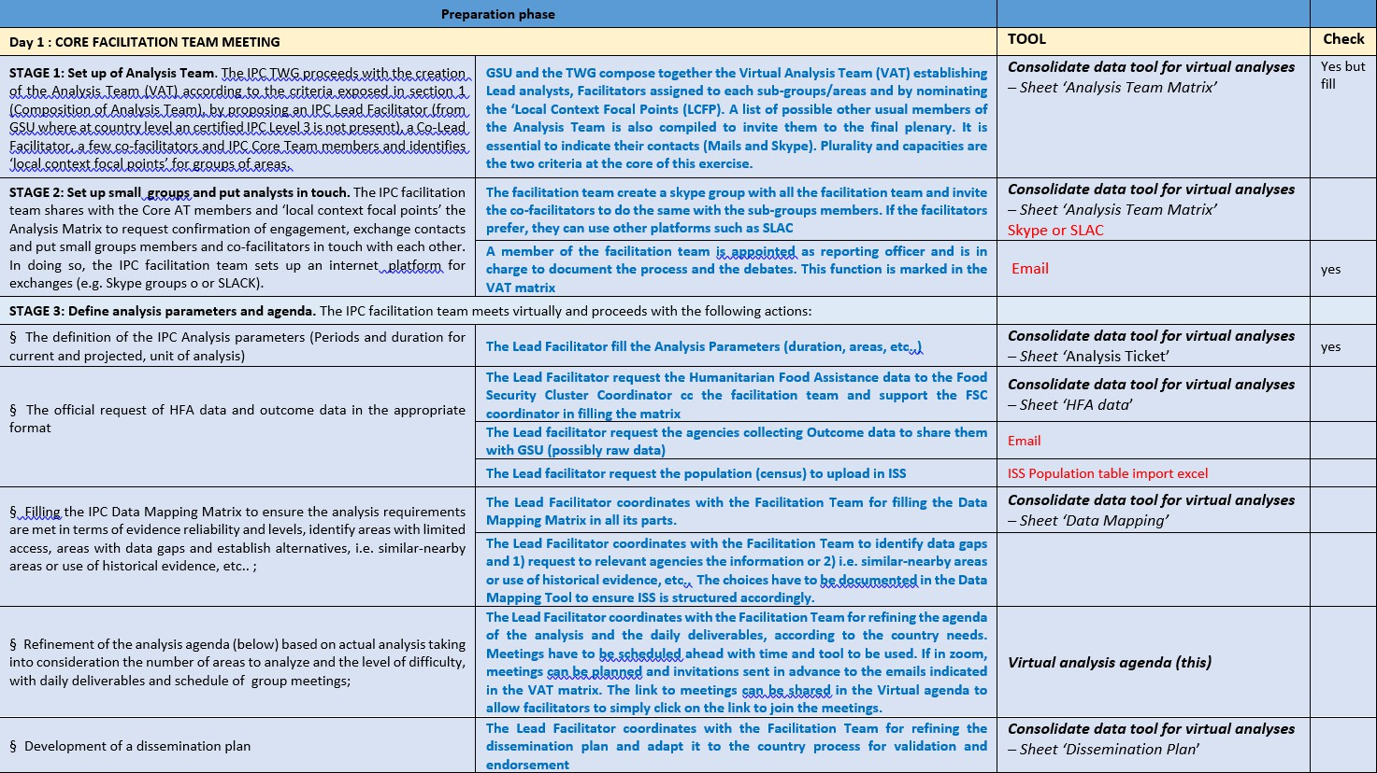
VIRTUAL ANALYSIS PREPERATION AGENDA

Slide 26
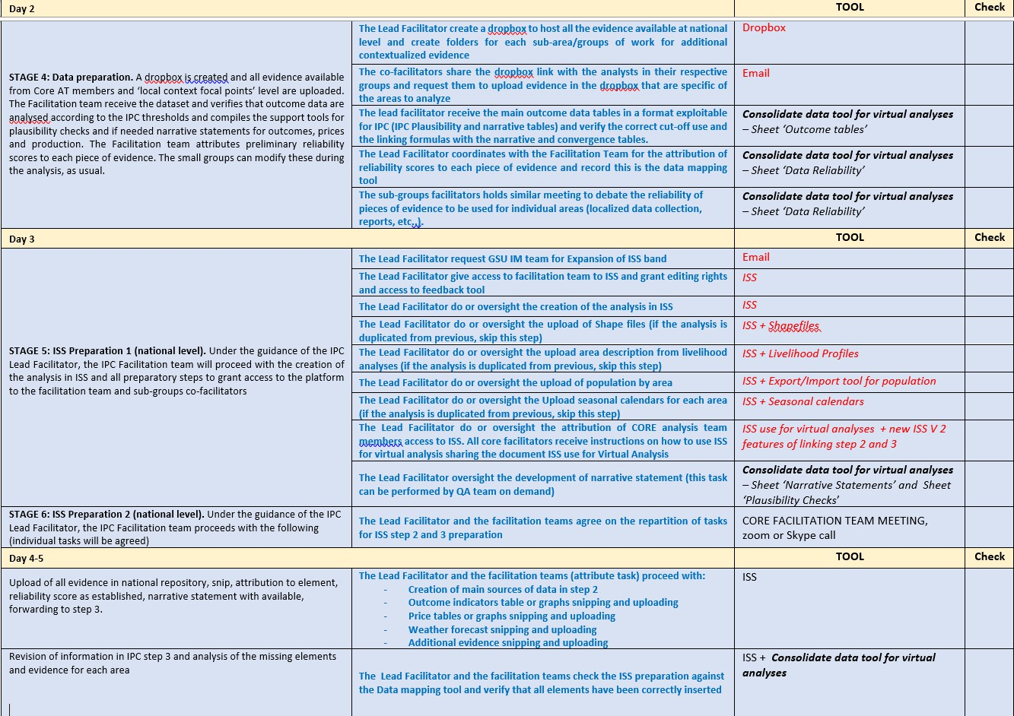

Slide 27
